Slide 1
Producers and Receivers
Modes of Communication

Slide 2
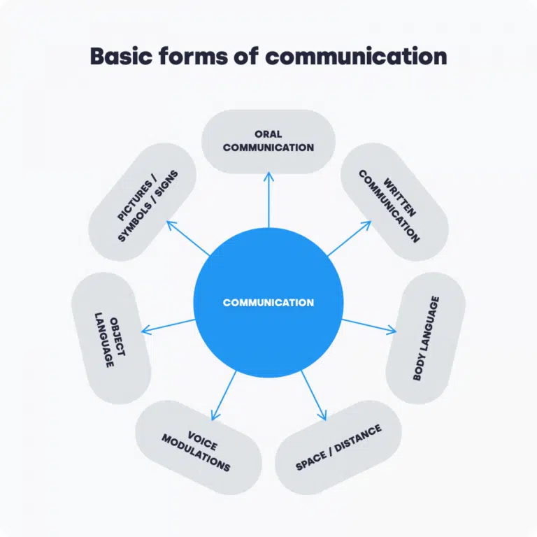


Types of Producers
A

Slide 3
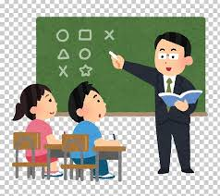
Types of Producers
Author of Speech
An author of speech is one who communicates out of his/her free will. An author of speech enjoys the ‘authority’ to express his/her thoughts in his/her own words. Teachers, students and individuals in their daily lives employ language of their own accord and hence are authors of their speech.

Slide 4
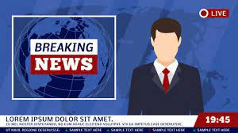
2. Mouthpiece
A mouthpiece is one who can neither employ his/her own words nor express his/her own ideas. A mouthpiece communicates someone else’s thoughts in given words. Newscasters who read out from the screen are examples of mouthpiece.

Slide 5

3. Spokesperson
A spokesperson is one who communicates someone else’s ideas but expresses in his/her own words. Ambassadors and Foreign Service Officials who communicate a given stance, albeit use their own words are an example of a spokesperson.

Slide 6

Types of Receivers
Auditors
The receivers of information who are physically present on the locale of communication are known as auditors. Students in a physical class room exemplify auditors.

Slide 7

2. Audience
Audience in terms of receivers of communication signifies participants who partake of communication but are not physically present on the venue of communication. For example, online learners are an example of audience..

Slide 8
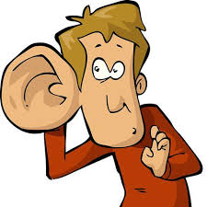
3. Eavesdropper
An eavesdropper is one who listens to a piece of information which s(he) is not entitled to listen to, A listener trying to catch hold of confidential information is an eavesdropper.

Slide 9
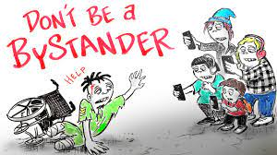
4. Bystander
A bystander is one who is physically present on the locale of communication and also listens to it but is not directly influenced by the communication.. For example, an electrician fixing a light amidst an ongoing lecture is an example of a bystander.

Slide 10
Business opportunities are like buses. There's always another one coming.
“
”
Richard Branson

Slide 11
Thank you
Dr. Sarah Syed Kazmi
sarahsk@ssuet.edu.pk

